Slide 1
WETLAND MANAGEMENT
ENV-541
A. Prof. Dr. Hina Chaudhry

Slide 2
Wetland
“Wetlands are lands transitional between terrestrial and aquatic systems where the water table is usually at or near the surface, or the land is covered by shallow water.”

Slide 3
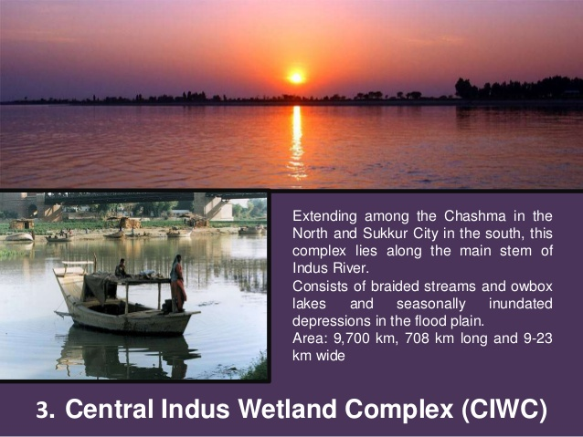

Slide 4
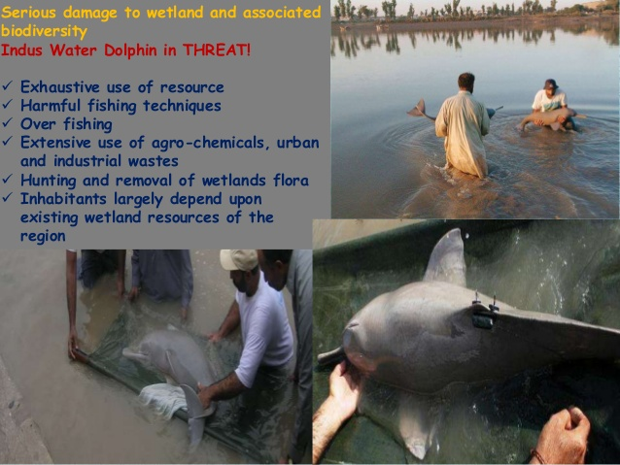

Slide 5
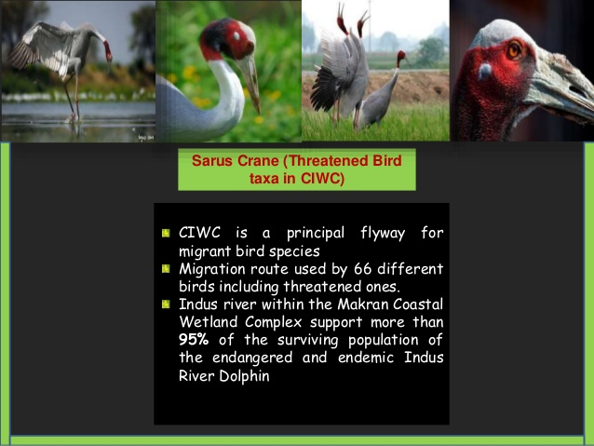

Slide 6
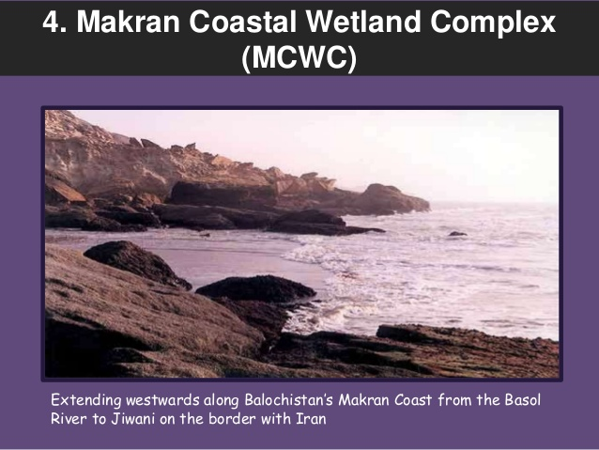

Slide 7
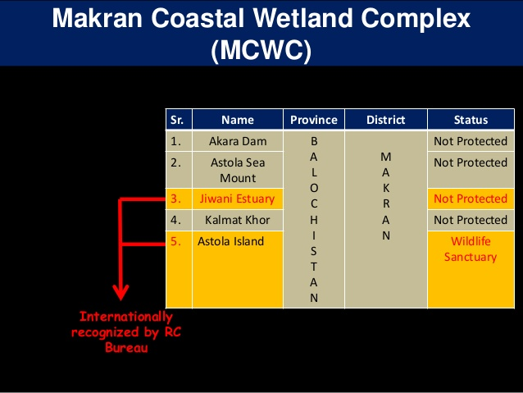

Slide 8
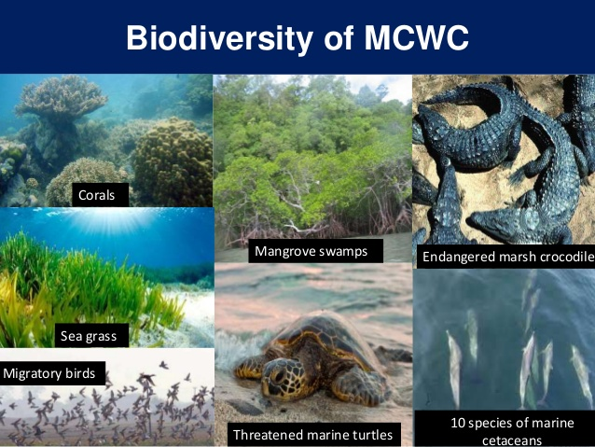

Slide 9
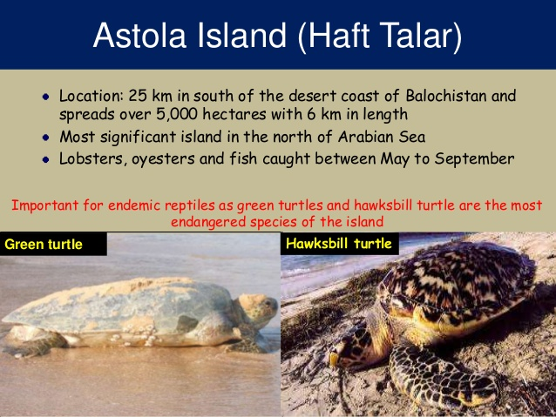

Slide 10
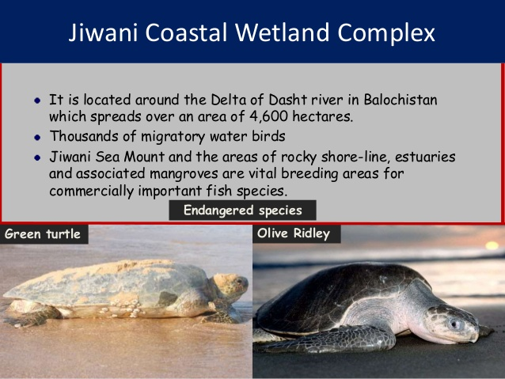

Slide 11
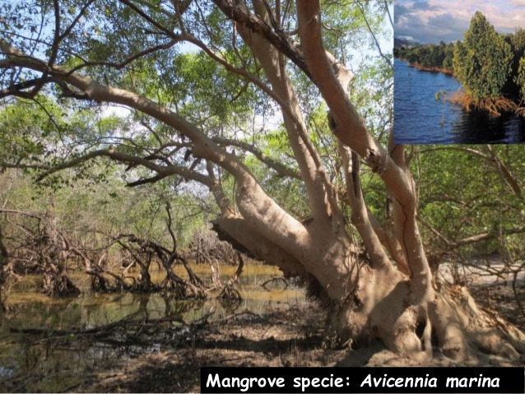

Slide 12
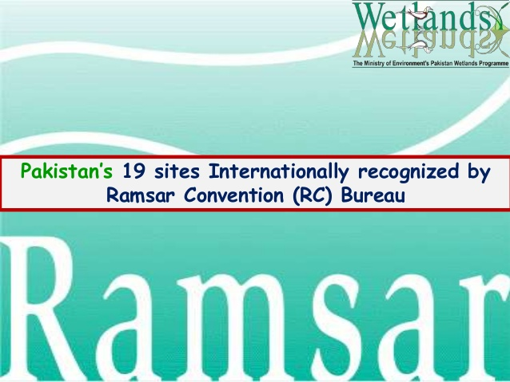

Slide 13
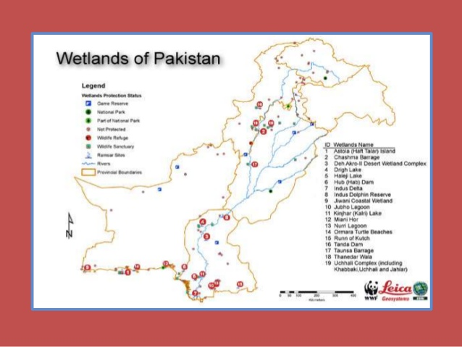

Slide 14
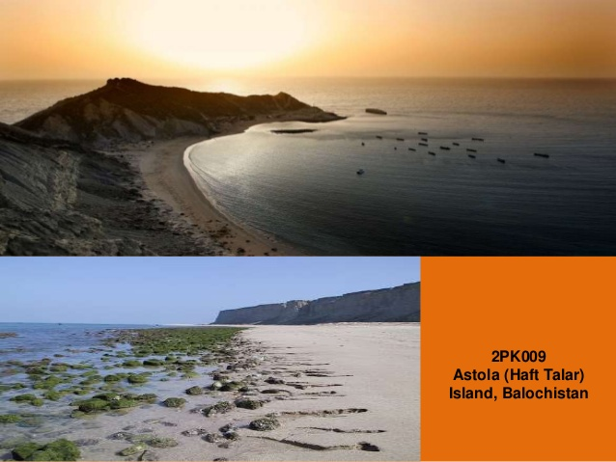

Slide 15
